Slide 1
Reservation System
Project Presented by Luke and Lauren

Slide 2
Project Overview
A restaurant just added some locations, so it needs a way to manage reservations for multiple locations. The hostess needs to be able to create, cancel, or update reservations. Also, if the location is at capacity, or the reservation is scheduled outside of normal operating hours, then the reservation should not be allowed to be made.
Acceptance Criteria
CRUD functionality for locations and reservations
if the location is at capacity, don't allow the a reservation to be created
Do not allow multiple reservations at the same time
Do not allow reservations to occur outside of business hours
You will need to stub out some data b/c the database has not been created yet

Slide 3
Overcoming Challenges
Challenges we faced
Checking capacity against already existing reservations
Using the DateTime and Timespan data types with JSON
Filtering Queries
Efficiency of code for DB scalability

Slide 4
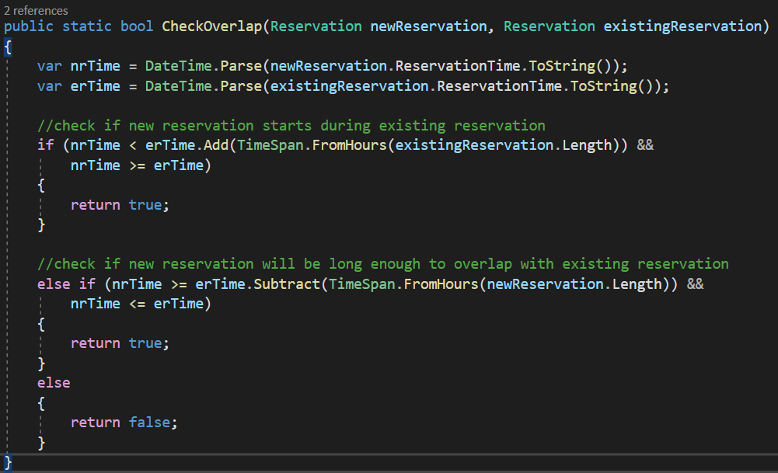
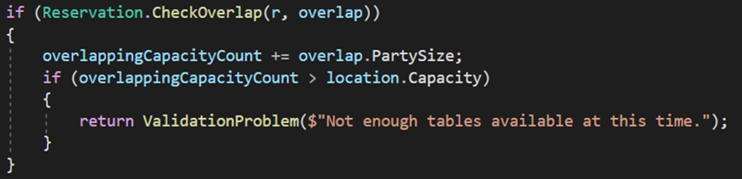
CheckOverlap Method
Developed CheckOverlap method
Encapsulated for easy reuse.

Slide 5
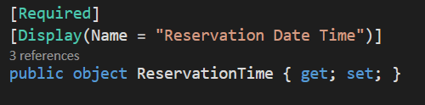
Issues with JSON
Ran into trouble getting JSON to display DateTime and Timespan.
The initial solution was to make these an object.
We then parse the data from the object into a DateTime data type

Slide 6
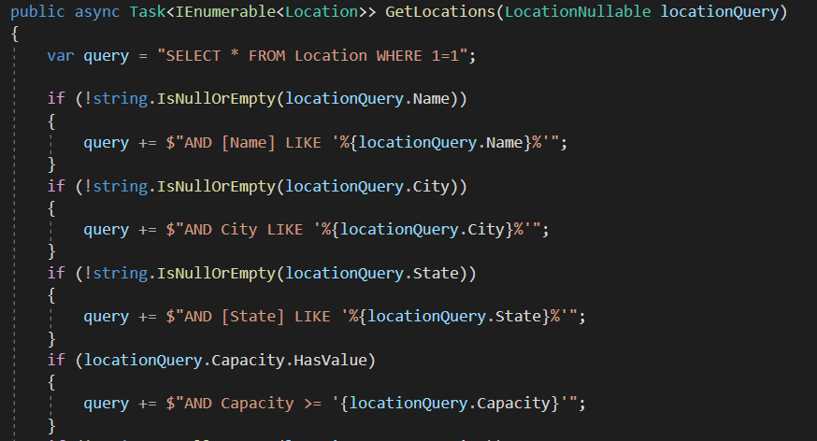
Query Filtering

Slide 7
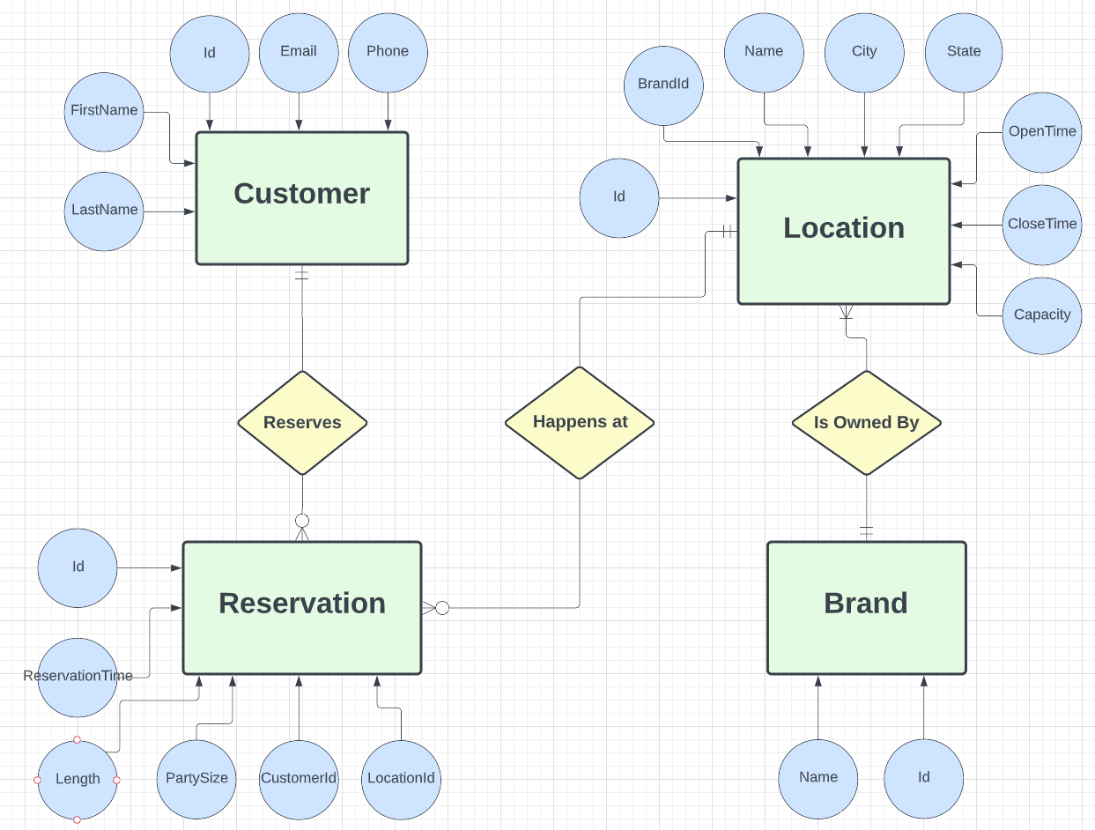
Entity Relationship Diagram

Slide 8
Brand
Attributes
Id
Name
Constraints
Must own at least one or more Locations
Exists in case this technology expands to include multiple brands

Slide 9
Customer
Attributes
Id
FirstName
LastName
Phone
Email
Constraints
Can have 0 or many Reservations

Slide 10
Location
Attributes
Id
Name
Street
City
Capacity
OpenTime
CloseTime
Constraints
Location must have 1 and only 1 Brand
Location may have 0 or more Reservations

Slide 11
Reservation
Attributes
Id
Length
PartySize
ReservationTime
CustomerId
LocationId
Constraints
Must have 1 and only 1 Customer
Must have 1 and only 1 Location

Slide 12
Use Cases
Brand manages current and new Location.
Customer calls to make reservation. Host adds customer and reservation.
Manager wants list of reservations at certain location on certain date.
Industry potential
Dental Offices
Gym Classes
Appointment Driven Services

Slide 13
Now for a demonstration…

Slide 14
Where Do We Go From Here?
Potential Expansions to Product Functionality
Search Locations by service type
Provide criteria for Customers
Give ability to check table availability separate from building capacity

